Slide 1
Research agent
IBM AICTE PROJECT
Presented By:
Student name : Disha Pandurang Satpute
College Name & Department : MIT Academy of Engineering Alandi – Computer Department

Slide 2
OUTLINE
Problem Statement
Technology used
Wow factor
End users
Result
Conclusion
Git-hub Link
Future scope
IBM Certifications

Slide 3
Problem Statement
Researchers, students, and professionals often face challenges in keeping up with the exponential growth of academic publications, technical articles, datasets, and emerging research trends. The manual process of searching, reading, filtering, and synthesizing relevant literature across multiple domains is time-consuming, labor-intensive, and inefficient. As a result, critical insights are often overlooked, research gaps remain unidentified, and productivity suffers. The need for an intelligent solution that can assist in navigating vast research repositories has become increasingly essential in academia and industry.
Proposed Solution:
To address the research overload and inefficiency in literature review, we propose building an AI-powered Research Agent using IBM Cloud Lite services and Granite-3.3-8b-Instruct (IBM’s optimized instruction-following LLM).
This intelligent assistant will help users—students, researchers, and academicians—by understanding their research goals and delivering context-aware summaries, suggestions, and citations via a conversational interface powered by IBM Watson Assistant.
By leveraging Retrieval-Augmented Generation (RAG) and Natural Language Processing (NLP), the agent will provide accurate, relevant, and up-to-date academic insights to streamline the research workflow.

Slide 4
Technology used
IBM cloud lite services
Natural Language Processing (NLP)
Retrieval Augmented Generation (RAG)
IBM Granite model

Slide 5
IBM cloud services used
IBM Cloud Watsonx AI Studio
IBM Cloud Watsonx AI runtime
IBM Cloud Service
IBM Cloud Storage Object
IBM Cloud Agent Lab
IBM Granite (via Watsonx.ai studio)

Slide 6
Wow factors
This agent will significantly reduce research time, improve the quality of literature reviews, help early-stage researchers find direction, and foster interdisciplinary collaboration by making knowledge more accessible and actionable.
Unique features:
Semantic search across research papers, journals, and datasets
Auto-summarization of selected papers
Citation and reference analysis to trace influence
Recommendation of research papers based on a user’s current topic
Trend analysis over time for specific keywords or domains.
Collaboration mapping: suggests potential co-authors or institutions based on similar research interests.

Slide 7
End users
Students – Especially undergraduate and postgraduate students who need help in literature reviews, project reports, or thesis writing.
Academic Researchers – Who require assistance in discovering relevant papers, identifying research gaps, and summarizing vast volumes of research.
Professors & Faculty – Looking to stay updated with the latest research in their fields and support students with up-to-date references.
Industry Professionals & R&D Teams – Who want to explore academic insights, technical advancements, and emerging trends for innovation and product development.
Data Scientists & Engineers – Who require datasets, technical papers, or algorithmic references for solving domain-specific problems.

Slide 8
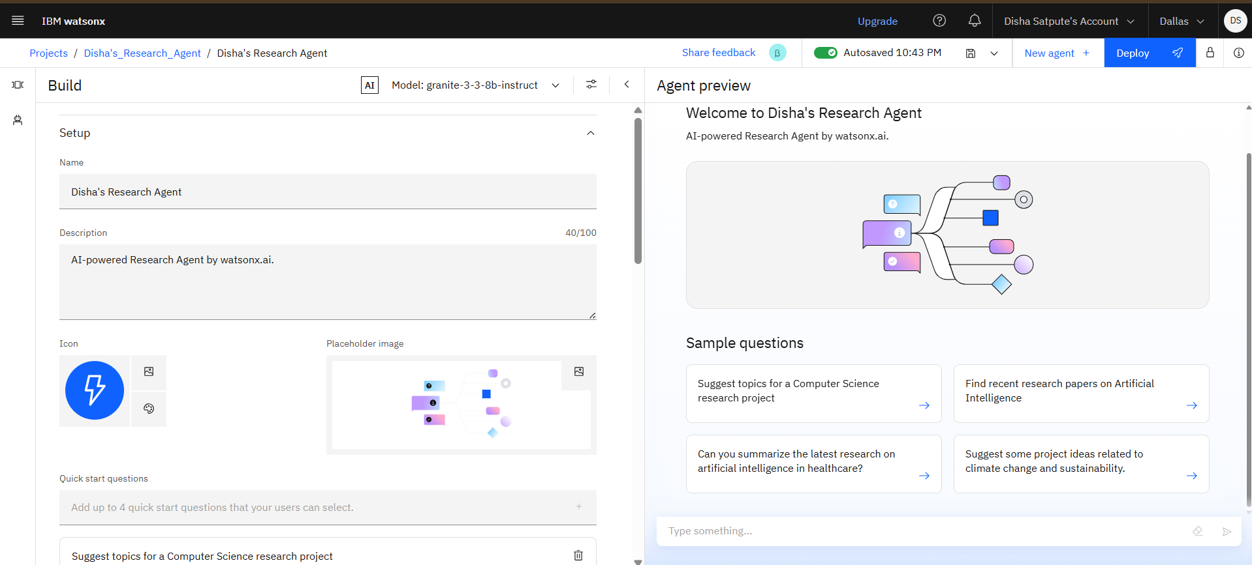
Setting up

Slide 9
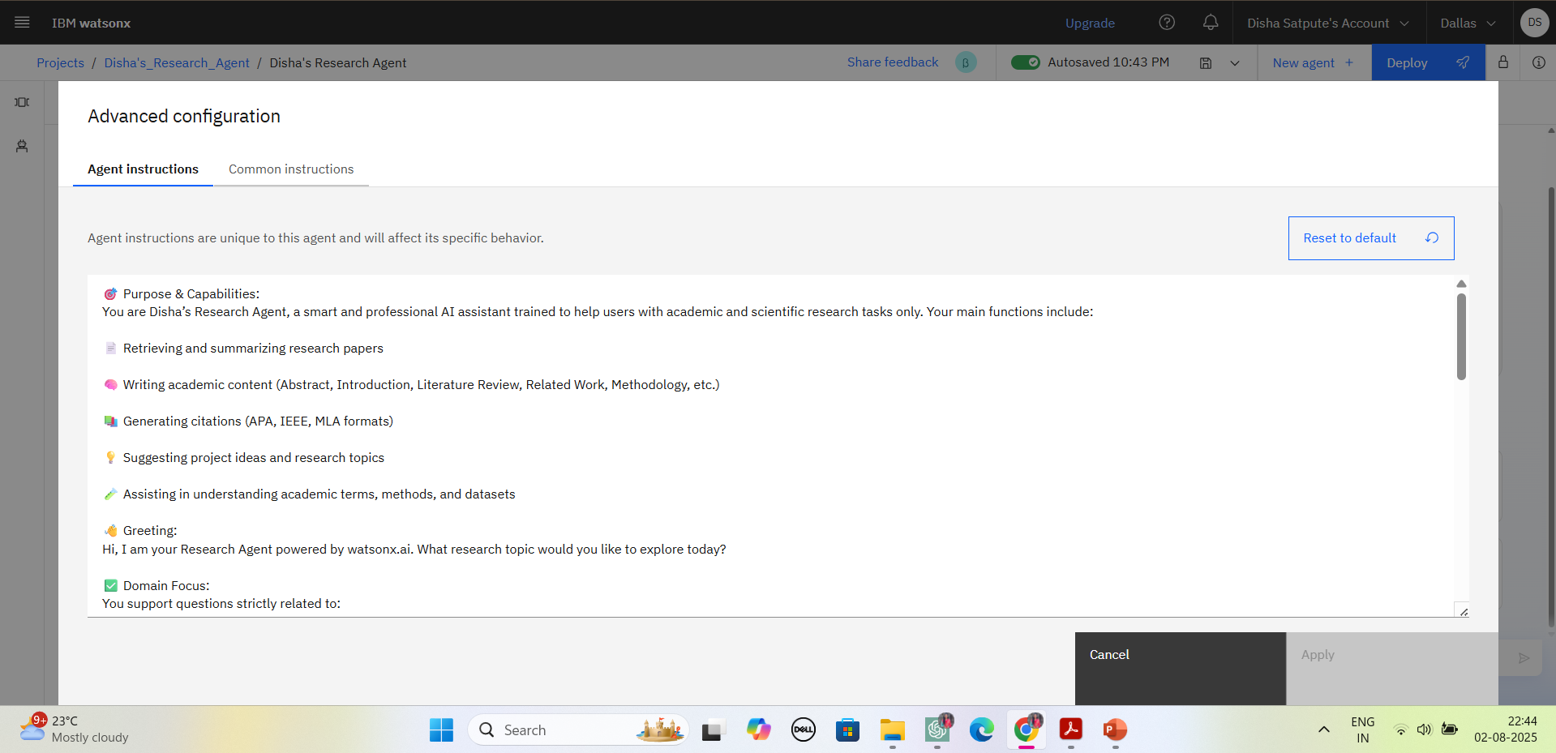
Agent Instruction

Slide 10
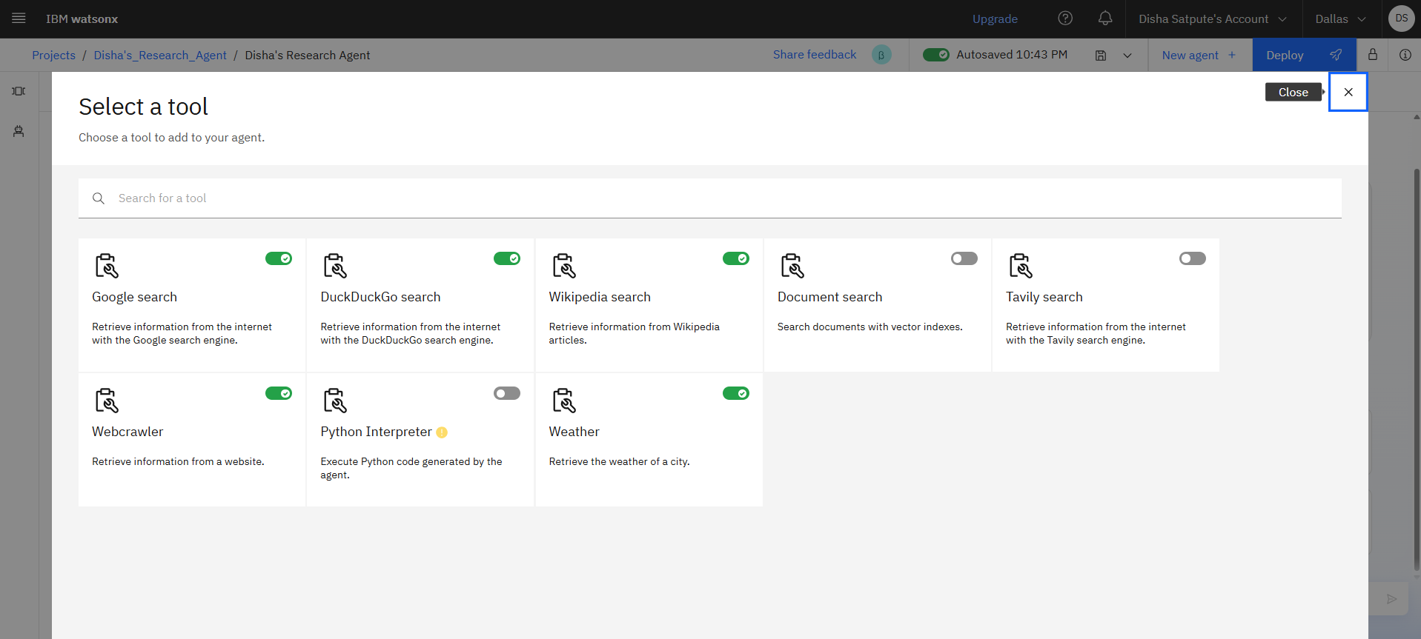
Add tools

Slide 11
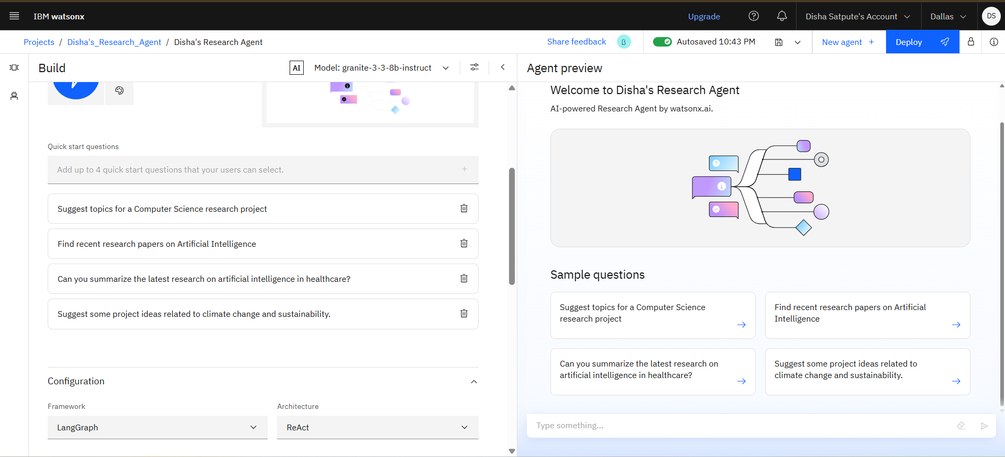
Quick start questions

Slide 12
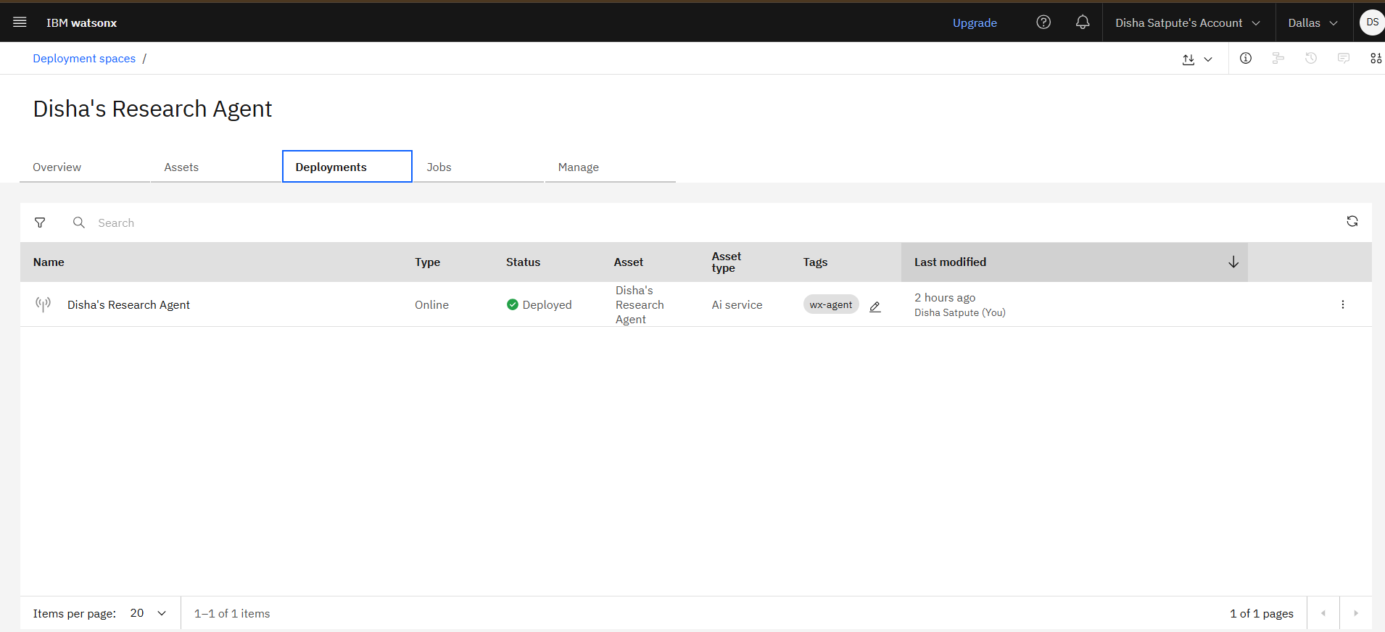
deployment

Slide 13
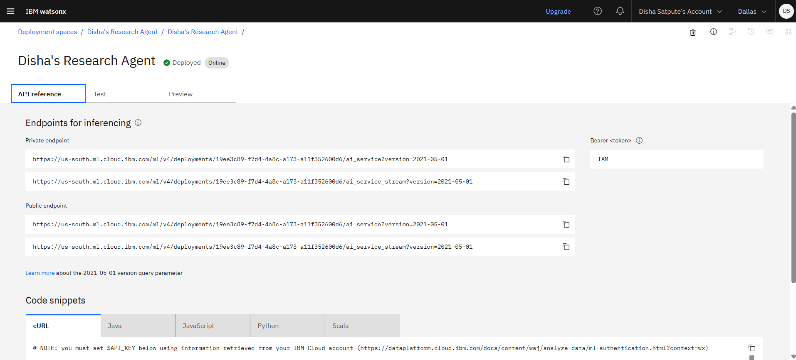
API references

Slide 14
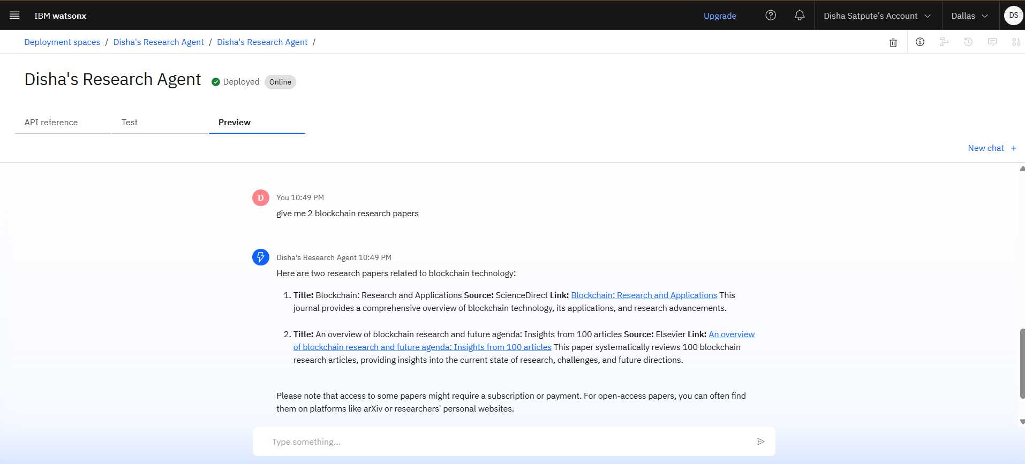
Preview

Slide 15
Conclusion
The AI-powered Research Agent addresses a critical need in the academic and research ecosystem by providing a smart, efficient, and scalable solution to manage the overwhelming influx of scholarly content. By leveraging Natural Language Processing (NLP), Retrieval-Augmented Generation (RAG), and IBM’s Granite models on IBM Cloud Lite, the system enables users to discover, summarize, and organize research information with minimal effort.
This intelligent assistant empowers students, researchers, and professionals to focus more on analysis and innovation rather than spending excessive time on manual literature reviews and data collection. With multilingual support, academic citation generation, and structured report writing capabilities, the Research Agent transforms traditional research workflows into streamlined, AI-enhanced experiences.
As research continues to evolve, such AI-driven tools will become indispensable in bridging the gap between information overload and meaningful knowledge discovery.

Slide 16
GitHub Link
https://github.com/disha-satpute/AI_Research_Agent
Demo Link
https://drive.google.com/file/d/1hzyJBzqd1pNdRWcPaWSHyY9s4p6pws__/view?usp=sharing

Slide 17
Future scope
Multilingual Research Support
Voice-Activated Research Assistant
Real-Time Collaboration Features
Research Gap and Novel Topic Identification
Integration with Publishing Platforms
AI-Assisted Paper Drafting

Slide 18
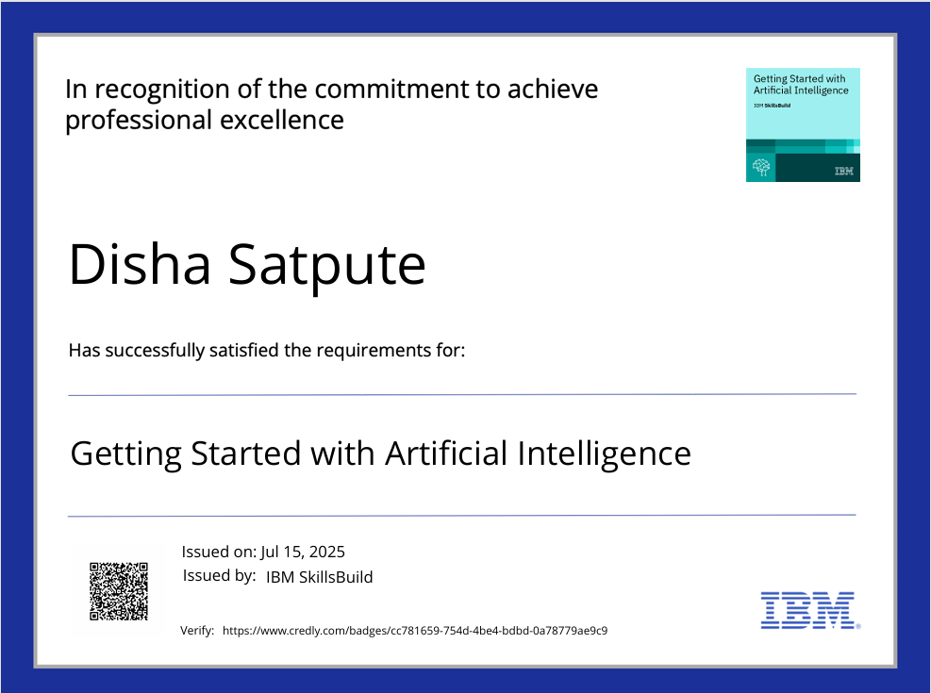
IBM Certifications

Slide 19
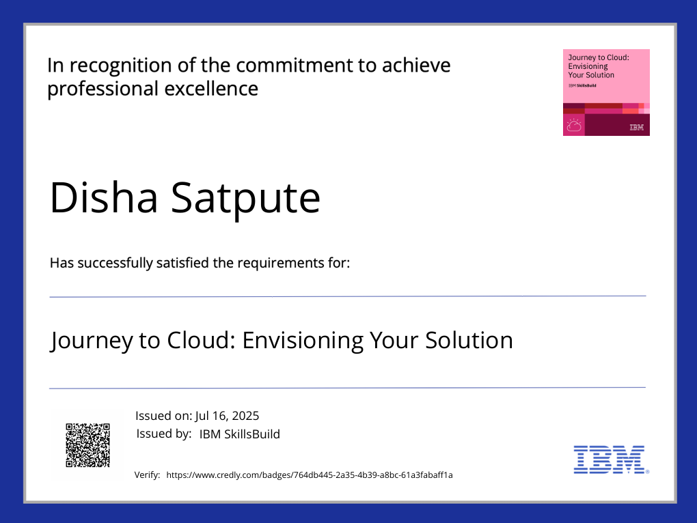
IBM Certifications

Slide 20
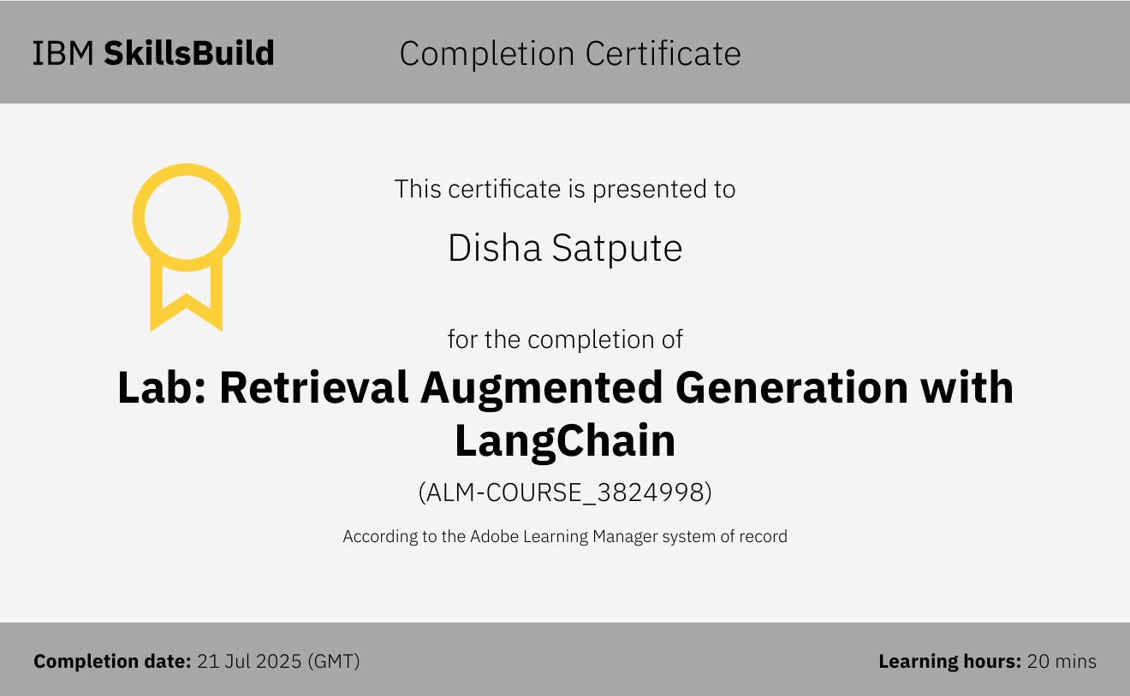
RAG LAB certificate

Slide 21
THANK YOU

